Slide 1



BTP Project
Topic : Memory optimization in Neural Networks for constrained Hardwares
Mentor : Dr. Binod Kumar
Group Members : Suyash Bansal (B20CS076)
Sudip Kumar(B20CS072)

Slide 2
Introduction
Problem Statement
Weight Augmentation
Motivation
Weight Centralisation
Observations
Conclusion
Future Improvements
Standard model testing

Slide 3

Problem Statement
The primary challenge with deploying neural networks on constrained hardware in AIOT applications is the limited memory and computational power, necessitating the need for effective solution.
Memory constraint does not allow the small IOT hardware devices to be able to perform computation intensive task involved in the deep learning based applications.
Performance Retention, is another important problem which is quite important to be addressed that the performance of the model should not dip more than certain threshold.

Slide 4


Motivation
Since memory is a limited resource, businesses frequently have to take the cost of acquiring and preserving memory into account. Improving memory efficiency can save money by lowering the requirement for more hardware. Optimizing memory usage enables more effective use of the resources that are available.
The memory capabilities of many contemporary gadgets, including smartphones and Internet of Things (IoT) devices, are constrained. In these situations, optimizing memory consumption is crucial to making sure that programs function properly without using up all of the available resources. As systems and applications get larger, effective memory management becomes essential.

Slide 5
Methodologies
Weight augmentation
Weight centralization
Standard & Custom Model Testing
Scalar addition
Scalar multiplication
Bit flip method
8 - Bit Quantization
Unitary weight centralization
Layer wise weight centralization
Batch wise weight centralization
Mobile Net v2
Shuffle Net v2
Squeeze Net
4 - layer MLP
5 - layer MLP

Slide 6
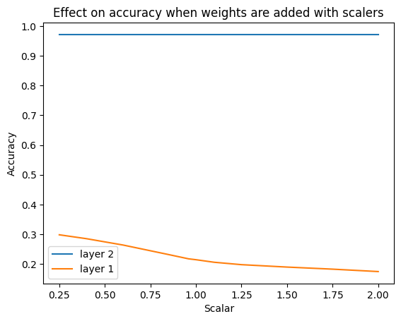
Weight Augmentation
Scalar addition
Scalar Addition is a method of augmenting the weights of the different layers of the neural networks by adding some noise in the form of some scalar quantities.
New weight = Original weight + scalar Noise .

Slide 7
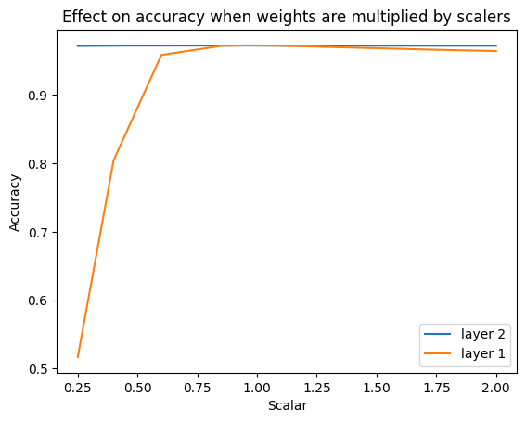
Weight Augmentation
Scalar Multiplication
It is another method for embedding noise in the values of the weights of the individual layers of the neural networks. Here the weights augmentation is observed by multiplying some scalar values to the weights of the layers in the neural network.
New weight = Original weight* scalar Noise .

Slide 8
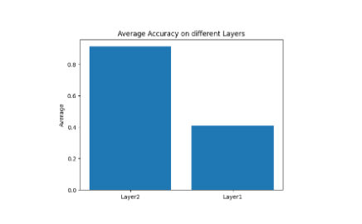
Weight Augmentation
Bit Flip Augmentation
Here in this method we randomly flip one of the bits of each original weight and after flipping bits for all the weights in the layer we evaluate the accuracy of the model.Number of bits flipped have been varied and then accuracy are calculated and then average accuracy is calculated.
As each weight is of 32 bits, randomly select one index and if the selected bit is ‘1’ then convert it to ‘0’ else if the selected bit is’0’ then change it to ‘1’

Slide 9
Weight Augmentation
8 - bit Quantization
Bit quantization is basically a method of scaling the 32 bits weights values to some reduced number of bits which would reduce the amount of memory used by the weights
Each weight is of 32 bits, so we just scaled that weights in the range of 8 bits so that it can have some quantized value corresponding to the 8 bit min to max value.
Here the accuracy of the original model comes out to be 96.17 % and on applying the 8-bit quantization accuracy did not drop much and it comes out to be nearly 91.23% and even applying it for all the dense layers it is working decently.

Slide 10
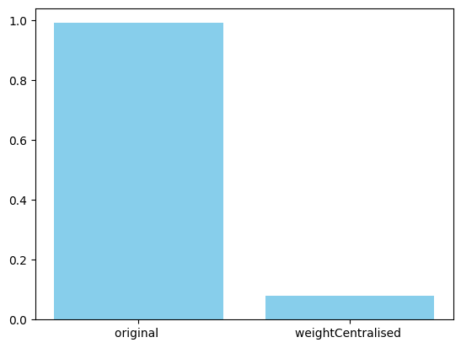
Weight Centralization
Unitary Weight Centralization
The main idea here is to generate a single central weight for all the layers of the whole neural network. This central weight then will be used to generate other weights on the go while inferencing on the model. To achieve this we calculate the mean of the weights of the whole network and standard deviation as well.
New_weight = random.uniform(mean - standard deviation , mean + standard deviation) + bias

Slide 11
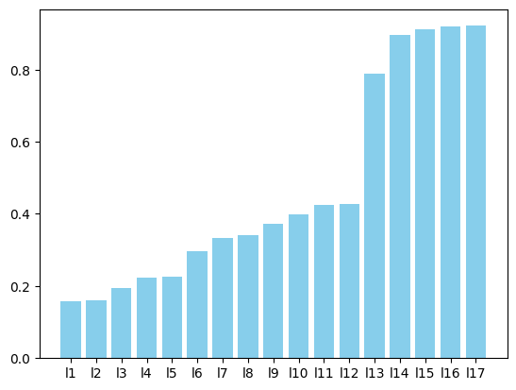
Weight Centralization
Layer Wise Weight Centralization
Layer wise centralisation of the weights is basically the centralisation of the weights by introducing some standard measure of central tendency for individual layers. Each dense layer will be having some central weights values instead of all the dense layer having just one central weight. Now with each layer possessing some central weight through which the rest of the weights are generated.
New_weight = random.uniform(mean - standard deviation , mean + standard deviation) + bias

Slide 12
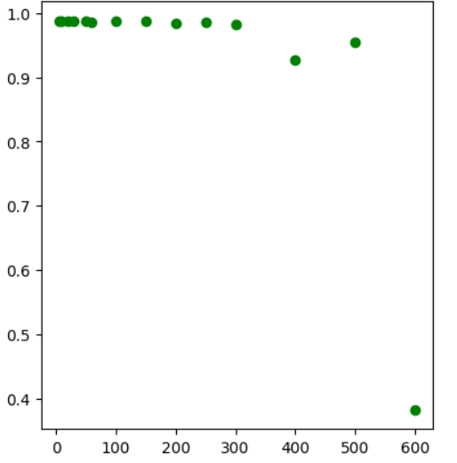
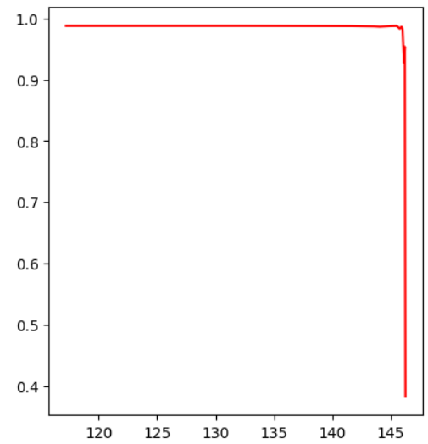
Weight Centralization
Batch Wise Weight Centralization
Batch wise Weight centralization is the method of generating some central weights replacing the large amount of weights which is dependent on the size of the batches into which it is divided.
Number of central weights = total number of weights / batch Size
The curve shows that after a certain threshold of the batch size accuracy has dropped significantly so ideal batch size should be selected for required application.
Accuracy vs Batch size Accuracy vs Memory optimized

Slide 13
Testing on Standard & Custom neural networks
MobileNet V2 model
ShuffleNet V2 model
SqueezeNet model
Custom 5 layer MLP
Custom 4 layer MLP

Slide 14
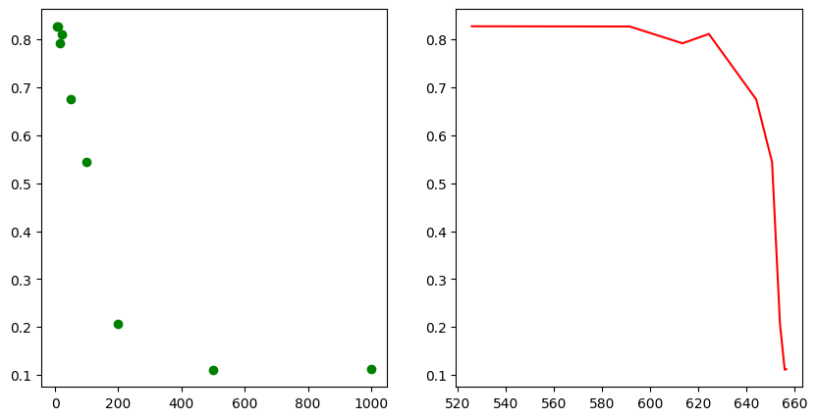
MobileNet V2 model
Mobile Net V2 is the lightweight standard model which is generally applied to real time general applications on the hardwares. Testing the memory optimization algorithm on the Mobile net v2 results are depicted in the graph.
Hardwares Based on the above graphs we got for the accuracy vs memory savings we can infer that the accuracy is dropped after batch size goes past 100 to 200 which means total weights / batch size will be the amount of memory it would have used for storing the central weights which includes the measures of central tendency.

Slide 15
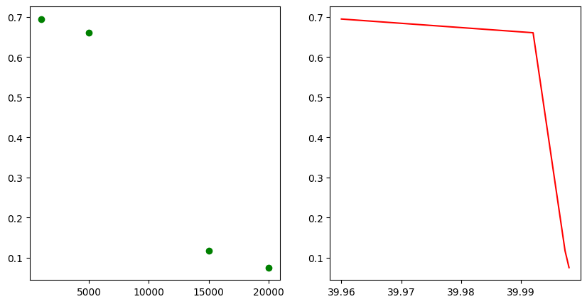
ShuffleNet V2 model
Shuffle Net v2 is another lightweight model which is highly used on low computation intensive hardware is a lightweight neural network architecture. It was created for effective and precise picture classification on systems with limited resources, such as mobile phones. ShuffleNetV2 modulates input channels by applying grouped convolutions, which split the channels into subsets and perform distinct convolutional operations on each subset. This reduces the computational cost relative to standard convolutions.
Abrupt decrease in the model's accuracy when the batch size is increased to 15K, indicating that there is a limit to how much the accuracy may be decreased and that doing so would render the model unsuitable for use in practical applications.

Slide 16
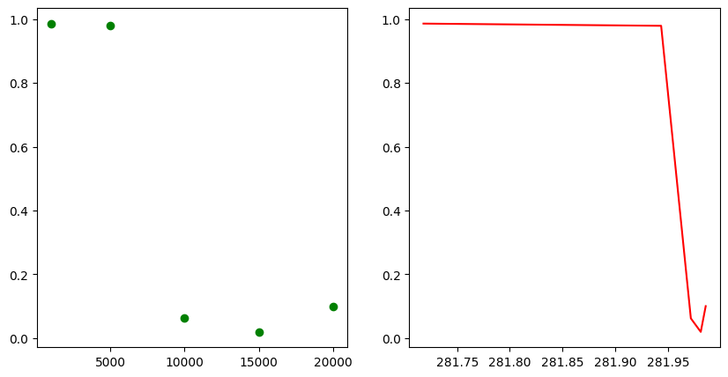
SqueezeNet model
It is incredibly accurate model with a significantly less number of parameters.
Uses "Fire Modules," which combine a squeeze layer (1x1 convolutional layer) and expand layers (1x1 and 3x3 convolutional layers), is one of its standout features.
Here, it is evident that accuracy decreases noticeably beyond a certain batch size, indicating that batch size 5000 serves as the threshold in this instance. Additionally, the amount of weighted memory that we are able to preserve in these circumstances is quite large—nearly 280–290 Mb, which is noteworthy.

Slide 17
Observations
Batch weight centralization can be universally applied to any model across diverse datasets by determining an optimal threshold batch size, ensuring its efficiency, effectiveness, and accuracy for the intended application.
The versatility of Batch weight centralization is demonstrated by its observed generalizability, which enables it to perform as intended when trained, tested, and developed with an appropriate batch size threshold in mind.
For mobileNet v2 we observed that out of these batch sizes [ 5, 10,15,20,50 , 100, 200 , 500 , 1000], 100 is most appropriate for maintaining the model's accuracy at a respectable level.
However, if we desired significant or whole memory saving from the neural network, we might use this memory optimization for mostly dense layer networks, which includes multilayer perceptron type neural networks.

Slide 18
Impact of weight centralization on accuracy
The primary determining element for the algorithm's success is the correctness of the model following the use of the Batch-Wise Weight Centralization procedure. As a result, the effect of weight centralization on accuracy can be examined as illustrated below.
 | Model | Dataset | Original accuracy | Threshold batch size | Memory Optimized Accuracy
1 | MobilenetV2 | MNIST | 82.99 % | 50 | 79.12
2 | ShuffleNetV2 | CIFAR 10 | 69 % | 5000 | 67.17
3 | SqueezeNet | A_Z dataset | 98.69% | 5000 | 97.79
4 | 5 layer MLP | covid 19 prediction | 92.76% | 200 | 85.50
5 | Custom 4 layer MLP | Poker hand prediction | 70.56% | 20 | 63.76

Slide 19
Memory size optimization
Another important component that determines how optimistic the approach is is how much memory is saved on the model once the Batch wise Weight centralization algorithm is done. Thus, it is possible to observe, as indicated below, how weight centralization affects the amount of memory saved.
 | Model | Dataset | Original accuracy | Threshold batch size | Memory Optimized
1 | MobilenetV2 | MNIST | 82.99% | 50 | 540 KB
2 | ShuffleNetV2 | CIFAR 10 | 69% | 5000 | 40 MB
3 | SqueezeNet | A_Z dataset | 98.69% | 5000 | 282 MB
4 | 5 layer MLP | covid 19 prediction | 92.76% | 200 | 87200 KB
5 | Custom 4 layer MLP | Poker hand prediction | 70.56% | 20 | 34 KB

Slide 20
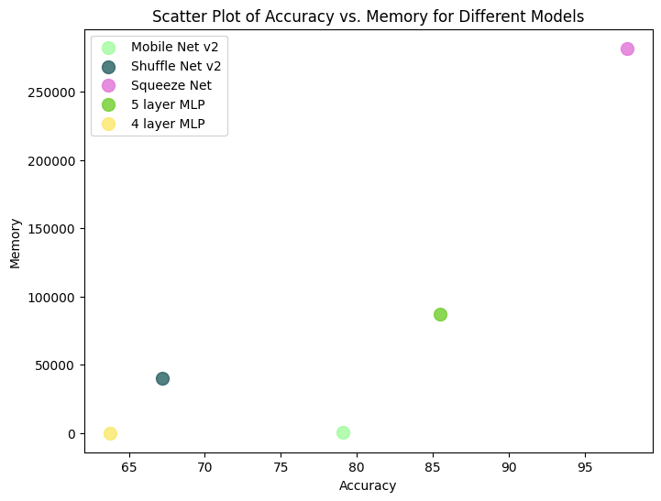
Accuracy VS Memory tradeoff
When making trade-offs between accuracy and memory savings, both should be taken into account. Obtaining an estimate for each of the parameters is crucial. The trade-off may now be understood for different models using the following graph.
Here in the graph it can be observed that for some data we have high accuracy as well as high memory savings while some might have low memory saving

Slide 21
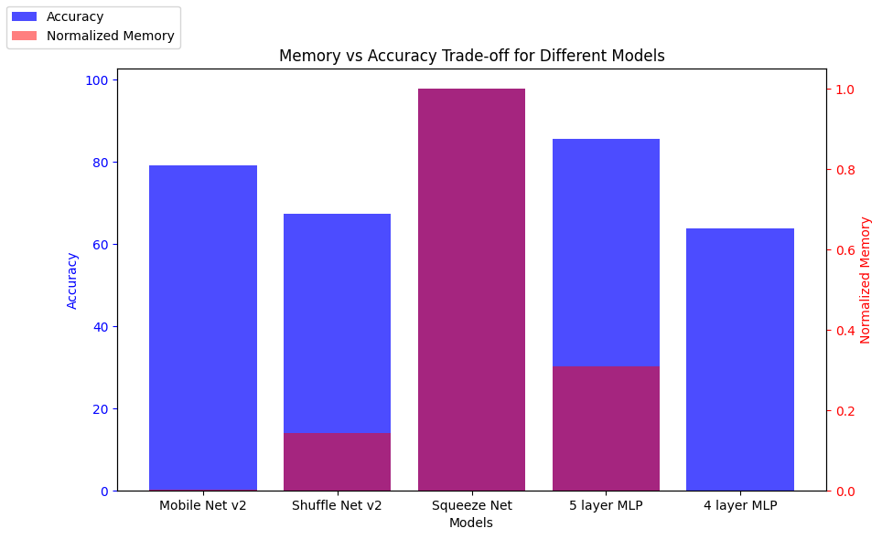
Accuracy VS Memory Barplot
The bar plot shows which model performs best based on what we can see; the pinkish color indicates that accuracy and memory savings are both high, but in MNIST and 4 layer MLP, it is evident that accuracy is controlled and memory is not as highly optimized as it is in the other models.

Slide 22
Conclusion
Augmenting weights in initial layers has a more pronounced impact on accuracy compared to augmenting weights in the last layers in a layer-wise fashion.
Batch-wise weight centralization proved to be a consistently effective method across various datasets and models, outperforming unitary weight centralization and layer-wise weight centralization, which demonstrated less consistent and generalizable accuracy improvements.
The Batch-wise weight centralization optimization algorithm was successfully applied and tested on various MLP models, including standard and non-standard ones like MobileNet V2, ShuffleNet V2, and SqueezeNet V2, revealing varying degrees of memory conservation across different models.

Slide 23

Future plan
Observing neural network weights, it's noted that many have zero magnitudes; leveraging this, omitting these weights in hardware operations by directly using bias values can enhance neural network efficiency and reduce computational load on the ALU section. This optimization improves hardware efficiency by avoiding unnecessary weight computations for zero-magnitude weights.
This method is termed as ‘Zero Skipping’ where we are skipping zeros multiplication and saving the time for its calculation.

Slide 24




Thank you

